Slide 1
Social Network Friend Recommendation System
Bhavna Nagar
Parag Dudeja
Under the supervision of
Dr. Bharti

Slide 2
Research Papers
Friend Recommendation using graph mining on social media, Kosaraju Naren Kumar (Student & Sathyabama University), Kanakamedala Vineela (Assistant Professor & NRI Institute of Technology)
Graph Convolutional Matrix Completion, Rianne van den Berg (University of Amsterdam), Thomas N. Kipf (University of Amsterdam), Max Welling(University of Amsterdam, CIFAR¹)
¹ Canadian Institute for Advanced Research

Slide 3
Friend Recommendation using graph mining on social media
Kosaraju Naren Kumar (Student &Sathyabama University) Kanakamedala Vineela( Assistant Professor & NRI Institute of Technology)

Slide 4
Recommendation System
A recommender system, or a recommendation system, is a subclass of information filtering system that provide suggestions for items that are most pertinent to a particular user. Typically, the suggestions refer to various decision-making processes, such as what product to purchase, what music to listen to, what people to connect, or what online news to read. Recommender systems are particularly useful when an individual needs to choose an item from a potentially overwhelming number of items that a service may offer.
Recommendation systems are used in innumerable types of areas such as generation of playlists, music and video services like Jio savaan, wynk, amazon prime music etc. and products recommendation for users in e-commerce applications and commercial applications.

Slide 5
Social Recommendation System
Social recommendation system is a system that recommends the friends in social media applications such as the Facebook, Twitter, Instagram etc.
In recent times social media is enjoying a great deal of success with a million of users visiting many sites like Facebook, Twitter etc. for social networking. The information that is very much interested by the users is suggested by the recommendation system by using information filtering techniques.
Social Recommendation system recommends friends to the users based on the ratings given by the users with similar interests and topics. It recommends the friends to the users by knowing the followers and followee of a particular user.

Slide 6
Abstract
“Recommendation systems are used for custom-made navigation by getting huge amount of data particularly in social media domain for recommending friends. A recommendation system act as a subclass for the information filtering system that pursue to predict the rating. The similarity measures that are calculated in this research are Jaccard distance and Otsuka-Ochiai coefficient. The feature extractions that are used in this paper are Adar index, PageRank, Katz centrality, Hits score.
The classification algorithm used is Random Forest Classifier.”

Slide 7
Highlights of the paper
Using a dataset of 9437519 nodes of both source and destination, in that entire volume of data 80% is used for training and 20% is used for testing for future predictions.
In this model the classification algorithm used is Random Forest Classifier. Random forest algorithm is a tree based algorithm, so it will works well for dimensional data and nonlinear separable data. Accuracy score is calculated by the precision, recall and F1 score. For describing the performance of the test data in a classification model confusion matrix is used.
The similarity measures that are calculated in this research are Jaccard distance and Otsuka-Ochiai coefficient. The feature extractions that are used in this paper are Adar index, PageRank, Katz centrality, Hits score.

Slide 8
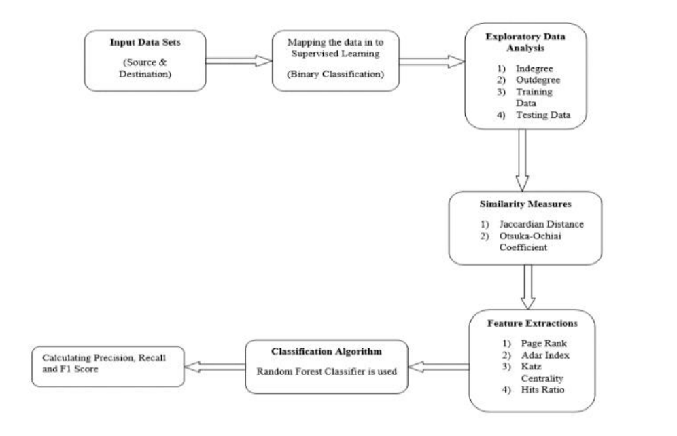
Proposed Solution

Slide 9
Dataset OverView
Dataset is taken from the Facebook's recruiting challenge on Kaggle and the dataset comprehends two columns such as Source and Destination
The volume the of dataset is approximately 94Lakhs, later on the data is fragmented into two types such as training data and testing data. 80% and 20% of the data is used for training and testing the data respectively
Total no of nodes presents in the data: 1862220, Total no of edges presents in the data: 9437519

Slide 10
MAPPING THE PROBLEM INTO SUPERVISED LEARNING PROBLEM
Generated training samples of good and bad links from given directed graph and for each link got some features like number of followers, is he followed back, page rank, katz score, adar index, some Svd features of adjacent matrix, some weight features etc. and trained ml model based on these features to predict link.

Slide 11
IN-DEGREE – The number of edges directed into a vertex in a directed graph is called in-degree. In other words, it can be defined as number of incoming nodes for a particular node. InDegree is used to find the number of followers for each user.
OUT-DEGREE – The number of edges directed away from the vertex in a directed graph is called out-degree.In other words, it can be defined as number of outgoing nodes for a particular node. Out-Degree is used to find the number of people each user is following.
For above node in-Degree is 2 and out-Degree is 3.

Slide 12


JACCARD DISTANCE –Jaccard distance is nothing but a measure of similarity between two data nodes ranging from 0% to 100%. As the Jaccard distance increases then there is a high chance of existing edge between the two nodes. It is defined as the size of the intersection of two sets to the size of the union of the two sets. It’s very sensitive towards small amount of data and gives flawed results.
COSINE-DISTANCE(OTSUKA–OCHIAI COEFFICIENT)-Otsuka-Ochiai coefficient is nothing but an intersection of the no of elements to the square root of the no of elements in A multiplied by number of elements in B.
PAGE RANK – PageRank is an algorithm that was designed to rank the importance of web pages. Given a directed graph the PageRank algorithm will give each vertex (Ui ) a score. The score represents the importance of the vertex in the directed graph. Networkx library is used to compute the PageRank.

Slide 13
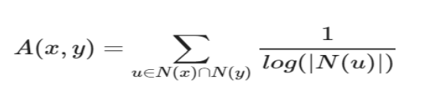
CHECKING FOR SAME WEAKLY CONNECTED COMPONENTS
If two users belonging to the same weakly connected components that gives the higher probability or higher chance of similar edge being present. Weakly connected component acts as a subgraph for the given directed graph. Weakly connected component acts as a strongly connected component in case of undirected graph.
ADAR INDEX– Adar Index Adar index or Adamic index is nothing but an inverted sum of degrees of common neighbors for given two vertices. Networkx library is used to compute the Adar index.

Slide 14

KATZ CENTRALITY – Based on the centrality of its neighbors Katz Centrality computes the centrality of a node. It is an inductive reasoning of the eigenvector centrality. The Katz centrality for node i is Formula J) – Katz Centrality Where A is the adjacency matrix of the graph G with eigenvalues λ. Networkx library is used to compute the Katz centrality
HITS SCORE – The HITS(Hyper Induced Topic Search) algorithm computes two no for a node. Based on the incoming links authorities estimates the node value. Based on outgoing links hubs estimates the node value. Networkx library is used to compute the HITS score.

Slide 15

WEIGHT FEATURES – An edge weight value was calculated between nodes in order to find the similarity of nodes. As the neighbor count goes up edge weight decreases. Intuitively, consider one million people following a celebrity on a social network then chances are most of them never met each other or the celebrity. Whereas on the other hand, if a user has 30 contacts in his/her social network, the chances are higher that most of them know each other. As it is directed graph, weighted in and weighted out are calculated separately.
SINGULAR VALUE DECOMPOSITION – For factorization of matrix into singular values and singular vectors SVD (Singular Value Decomposition) algorithm is used. SVD features for both source and destination nodes SVD is widely used in machine learning reduction techniques and matrix calculations

Slide 16
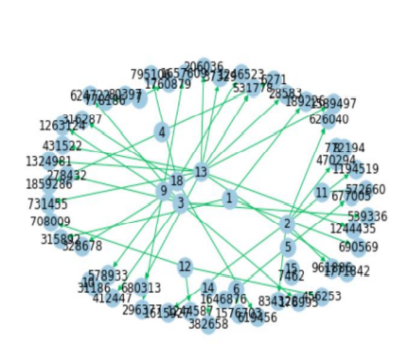
Experiment Results and Discussions.
Subgraph-the directed graph obtained from the dataset. By this digraph number of edges and nodes are calculated.
The no of nodes in the subgraph are: 66
The no of edges in the subgraph are: 50
The average In-Degree of the above subgraph: 0.7576
The average Out-Degree of the above subgraph: 0.7576

Slide 17
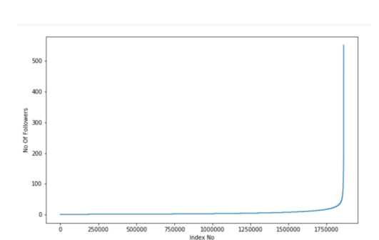
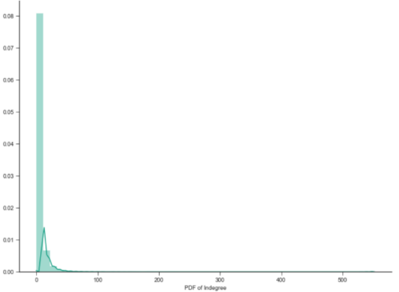
In-Degree graph-With help of In-Degree graph we calculate the number of followers for each person.
PDF of In-Degree Graph The below probability density function graph shows that very less number of people will be getting followed more number of followers.

Slide 18
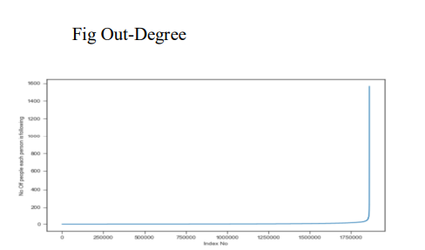
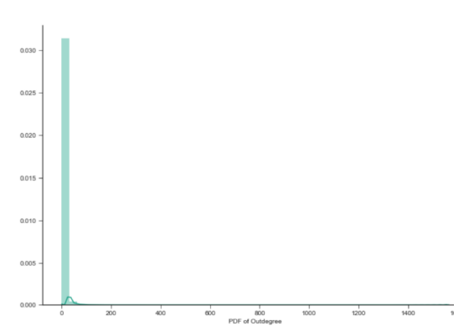
OUT-DEGREE GRAPH The below Out-Degree graph shows that number of persons that each person is following.
PDF of Out-Degree Graph The below probability density function shows that very less number of people will follows the more number of people

Slide 19
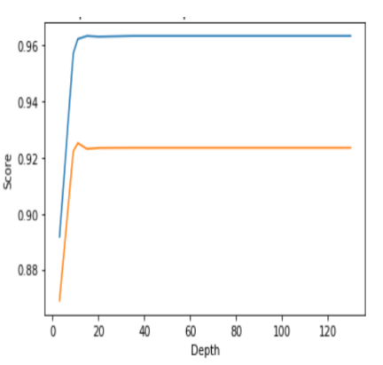
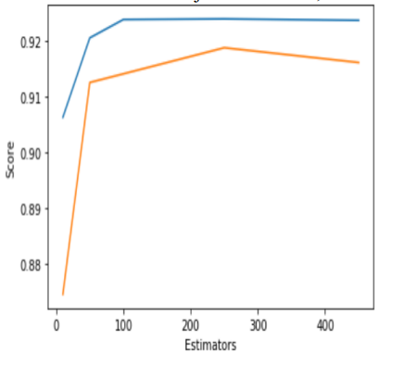
Depth and Estimator Graph
Graphs after calculating F1 Score

Slide 20
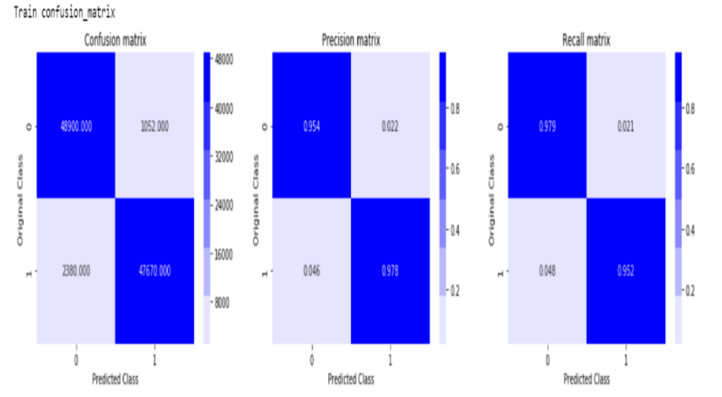
Confusion Matrix Graphs
Train Confusion matrix

Slide 21
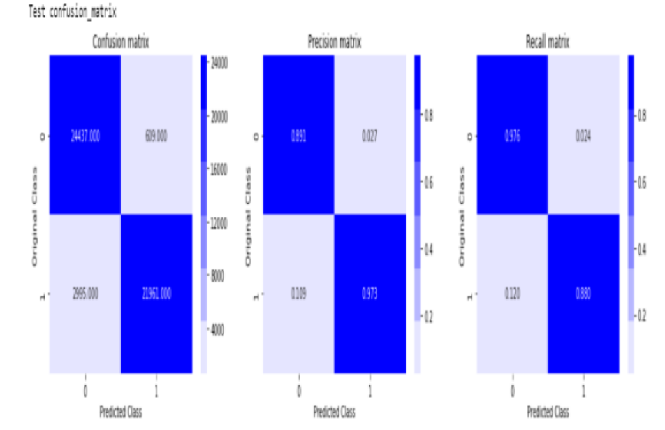
Test Confusion Matrix
From the above confusion matrix we infer that the accuracy score of the train matrix is 95% and accuracy score of test matrix is 89%.

Slide 22
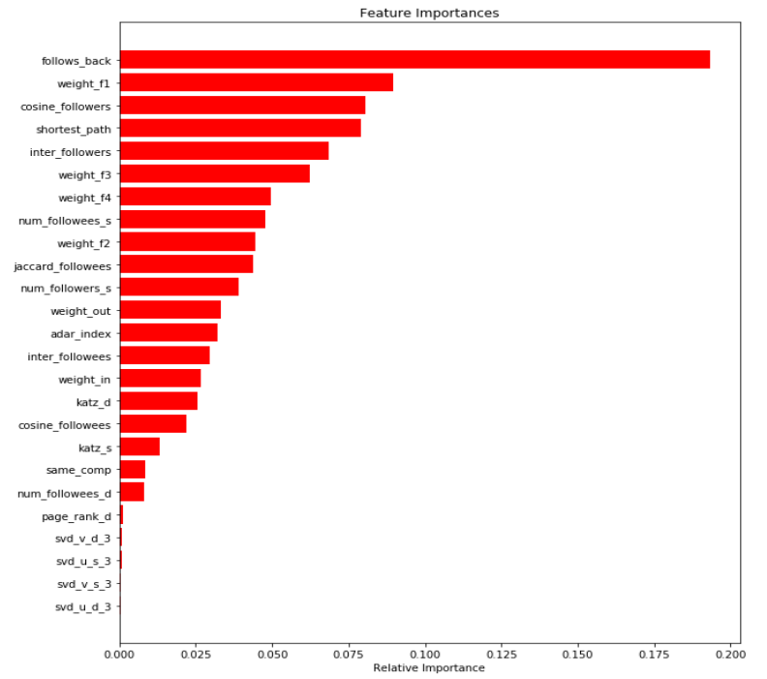
Feature Extraction Graph
The below graph shows the differences and importance of the feature extractions that are calculated and obtained in a form of the bar graph From the graph we can say that follows_back feature is most important extraction compared to other features and SVD(Singular Value Decomposition) is the least preferred one.

Slide 23
Conclusion
The proposed system develops a friend recommendation system to suggest friends to the users using Random Forest Classifier. With the help of the proposed system this recommendation model is working with the accuracy of 89%. This is quite reasonable for the hardware and the volume of data that we have. Our data set consists of 94 lakhs nodes. Performance metrics for this model is obtained by calculating Precision, Recall and F1 score.The most important feature extraction that we calculated is follows_back. feature. For the better results and accuracy Preferential attachment, SVM classifier and Graph neural networks can be used. This can improve the performance of the model in future

Slide 24
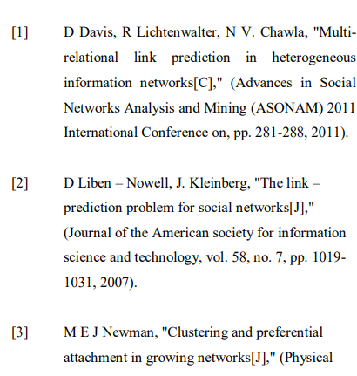
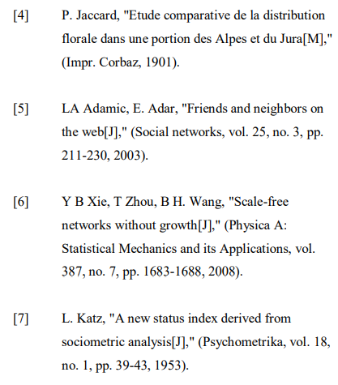
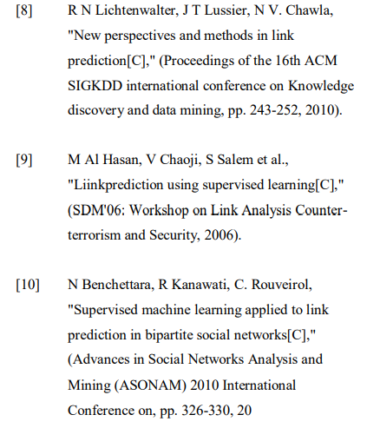
Bibiliography
IJETMS-SE-016.pdf

Slide 25
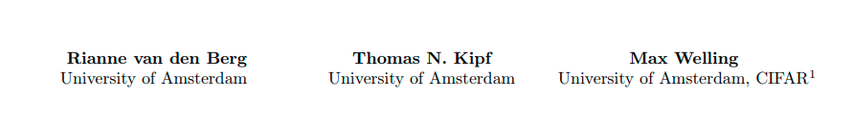
Graph Convolutional Matrix Completion

Slide 26
About recommender algorithms
Two main branches of recommender algorithms are often distinguished: content-based recommender systems [24] and collaborative filtering models [9].
Content-based recommender systems use content information of users and items, such as their respective occupation and genre, to predict the next purchase of a user or rating of an item.
Collaborative filtering models solve the matrix completion task by taking into account the collective interaction data to predict future ratings or purchases.

Slide 27
Abstract
“We consider matrix completion for recommender systems from the point of view of link prediction on graphs. Interaction data such as movie ratings can be represented by a bipartite user-item graph with labeled edges denoting observed ratings. Building on recent progress in deep learning on graph-structured data, we propose a graph auto-encoder framework based on differentiable message passing on the bipartite interaction graph. Our model shows competitive performance on standard collaborative filtering benchmarks. In settings where complimentary feature information or structured data such as a social network is available, our framework outperforms recent state-of-the-art methods.”

Slide 28
Highlights of the paper
matrix completion as a link prediction problem on graphs
the interaction data in collaborative filtering can be represented by a bipartite graph between user and item nodes, with observed ratings/purchases represented by links.
Content information can naturally be included in this framework in the form of node features.
Predicting ratings then reduces to predicting labeled links in the bipartite user -item graph.

Slide 29
Proposed solution
graph convolutional matrix completion (GC-MC): a graph-based auto-encoder framework for matrix completion, which builds on recent progress in deep learning on graphs [2, 6, 19, 5, 15, 30, 14]
The benefit of formulating matrix completion as a link prediction task on a bipartite graph becomes especially apparent when recommender graphs are accompanied with structured external information such as social networks.

Slide 30
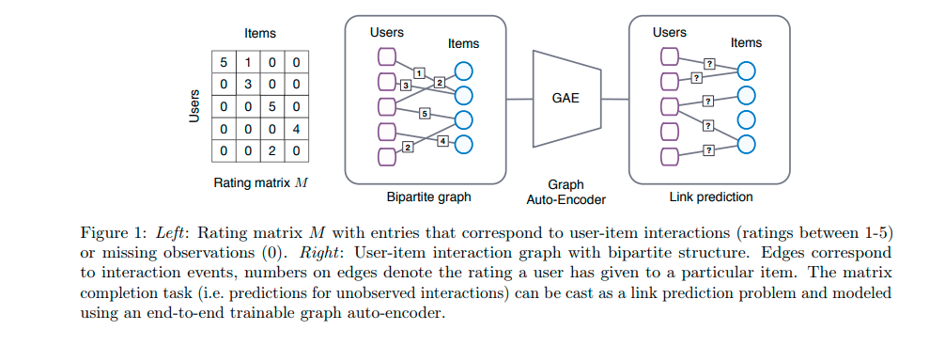
Matrix completion as link prediction in bipartite graphs
rating matrix M of shape Nu × Nv, where Nu is the number of users and Nv is the number of items. Entries Mij in this matrix encode either an observed rating (user i rated item j) from a set of discrete possible rating values, or the fact that the rating is unobserved (encoded by the value 0)

Slide 31
The task of matrix completion or recommendation can be seen as predicting the value of unobserved entries in M.
Previous graph-based approaches for recommender systems (see [18] for an overview) typically employ a multistage pipeline, consisting of a graph feature extraction model and a link prediction model, all of which are trained separately.
Recent results, however, have shown that results can often be significantly improved by modeling graph-structured data with end-to-end learning techniques [2, 6, 19, 23, 5, 15, 21] and specifically with graph auto-encoders [30, 14] for unsupervised learning and link prediction.

Slide 32
Graph auto-encoder
Graph autoencoders are comprised of
A graph encoder model Z = f(X, A), which take as input an N ×D feature matrix X and a graph adjacency matrix A, and produce an N × E node embedding matrix Z = [z^{T}₁ , . . . , z^{T}_{N} ]^{T}
A pairwise decoder model Aˇ = g(Z), which takes pairs of node embeddings (zi , zj ) and predicts respective entries Aˇ ij in the adjacency matrix.

Slide 33


Graph convolutional encoder
We can assign a specific transformation for each rating level, resulting in edge type specific messages µ_{j}→_{i,r} from items j to users i of the following form
and by subsequently accumulating them into a single vector representation

Slide 34

To arrive at the final embedding of user node i, we transform the intermediate output hi as follows
We will refer to (2) as a graph convolution layer and to (3) as a dense layer.

Slide 35


Bilinear decoder
For reconstructing links in the bipartite interaction graph we consider a bilinear decoder, and treat each rating level as a separate class. Indicating the reconstructed rating between user i and item j with Mˇ_{ij} , the decoder produces a probability distribution over possible rating levels through a bilinear operation followed by the application of a softmax function:
with Q_{r} a trainable parameter matrix of shape E × E, and E the dimensionality of hidden user (item) representations u_{i} (v_{j} ). The predicted rating is computed as

Slide 36
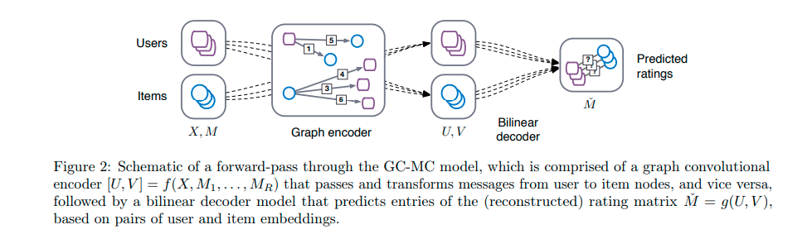
Putting it all together

Slide 37

Model training
Loss function: During model training, we minimize the following negative log likelihood of the predicted ratings Mˇ ij :
with I[k = l] = 1 when k = l and zero otherwise. The matrix Ω ∈ {0, 1} Nu×Ni serves as a mask for unobserved ratings, such that ones occur for elements corresponding to observed ratings in M, and zeros for unobserved ratings.
Node dropout and mini-batching is used in training the model

Slide 38
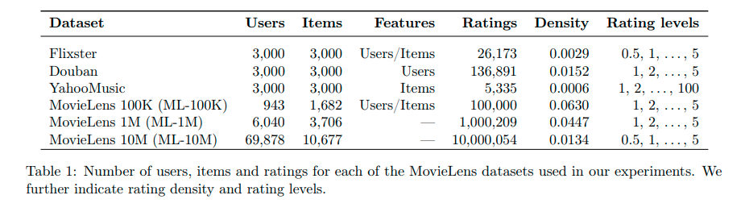
Experiments
Model was evaluates on a number of common collaborative filtering benchmark datasets: MovieLens2 (100K, 1M, and 10M), Flixster, Douban, and YahooMusic. The datasets consist of user ratings for items (such as movies) and optionally incorporate additional user/item information in the form of features. For Flixster, Douban, and YahooMusic we use preprocessed subsets of these datasets provided by [22] 3 . These datasets contain sub-graphs of 3000 users and 3000 items and their respective user-user and item-item interaction graphs (if available).

Slide 39
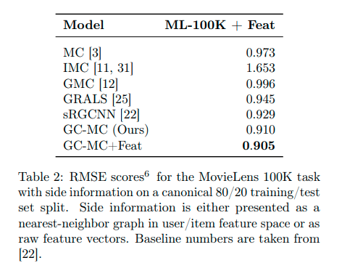
Summary of Results

Slide 40
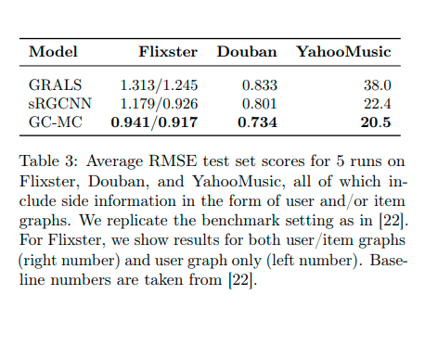

Slide 41
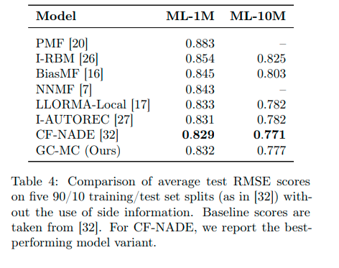

Slide 42
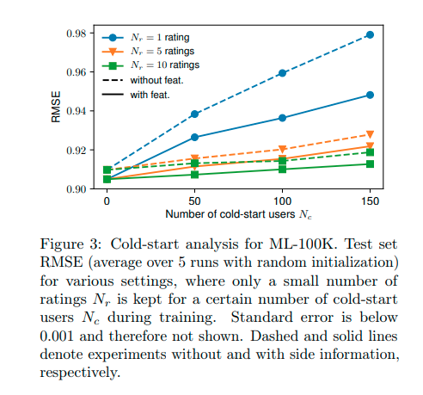

Slide 43
Conclusions
In this work, the authors have introduced graph convolutional matrix completion (GC-MC): a graph auto-encoder framework for the matrix completion task in recommender systems.
The encoder contains a graph convolution layer that constructs user and item embeddings through message passing on the bipartite user-item interaction graph.
Combined with a bilinear decoder, new ratings are predicted in the form of labeled edges.
Proposed model outperforms recent related methods by a large margin, as demonstrated on a number of benchmark datasets with feature- and graph-based side information.

Slide 44
In future work, the authors wish to extend this model to large-scale multi-modal data (comprised of text, images, and other graph-based information), such as present in many realistic recommendation platforms.
To address scalability, it is necessary to develop efficient approximate schemes, such as subsampling local neighborhoods

Slide 45
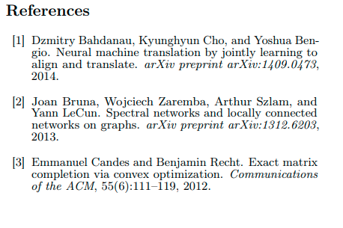
Bibiliography
https://arxiv.org/pdf/1706.02263v2.pdf

Slide 46
